Slide 1
Student Organization System (SOS)
Team Members:
Armando J. Ochoa – Primary Facilitator
Yovanni Jones - Developer
Anthony Sanchez-Ayra – Team Leader
Teriq Douglas – Minute Taker
M.Kian Maroofi – Time Keeper
Date: 10/01/2019

Slide 2
Purpose and Scope of System
Provide a single point of access to all users to
Check all the organizations they belong to.
Find events that are hosted nearby by organizations.
Discover new organizations.
Connect with other members.
Provides tools to manage organization leaders and their privileges.
Provides means to create and advertise organization-related events.
Out of Scope:
Social Media Features (comments and postings).
Organization finance management.

Slide 3
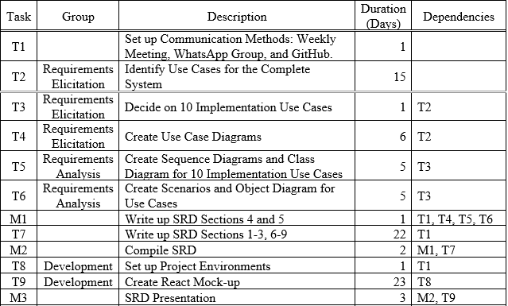
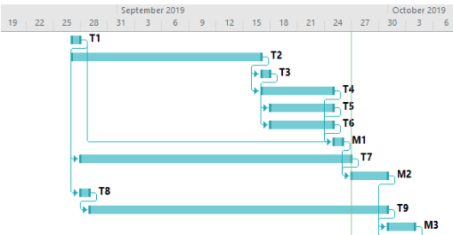
Project Schedule

Slide 4
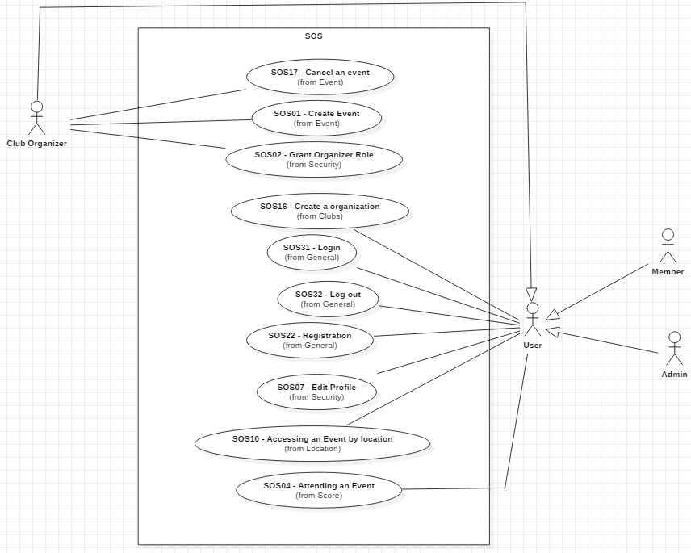
UML Diagram

Slide 5
SOS16 Create Organization Functional Requirements:
User must have an account in the webpage and logged in.
User clicks on “Organization Tab.”
The webpage switches to organization page.
User click on “Create Organization.”
User then fills out form asking for the organization details.
User submits form to the organization page.
User becomes Club Organizer for the organization, and it appears on the page.

Slide 6
SOS16 Create Organization Nonfunctional Requirements:
Usability
On average the user should take 2 minutes to complete the request.
Reliability
Mean time to failure – 5% failures for every month of operation is acceptable.
Performance
System should be able to handle 200 requests in 1 minute and process each in 6 sec.
Criticality
High. Allows the user to create an organization which is a main purpose of the system.
Frequency:
20 organization requests are made monthly by Users.
Notes:
Risk to implement is medium since it requires web-based technology.

Slide 7
SOS07 Edit Profile Functional Requirements:
User must have an account in the system and be logged in.
User is in their profile page and clicks “Edit Profile.”
User is then shown their current information in an editable form.
User inputs the data they would like to change.
User submits the request to change their information.
The webpage prompts the user for their password.
User inputs password and submits.
System authenticates their request.
System then changes user information in the data storage.
User receives notification that their profile has been successfully edited.

Slide 8
Use Case SOS07 Edit Profile Nonfunctional Requirements:
Usability
User must be aware of their privileges and what actions those privileges permit.
Reliability
Mean Time to Failure – 1% failure yearly is acceptable.
Performance
The system should handle 20 privilege checks in 1 minute and process each ~2 seconds.
Criticality
Low. Editing the user’s profile is a secondary feature of the system.
Frequency:
On average 20 users will edit their profile settings on a given month.

Slide 9
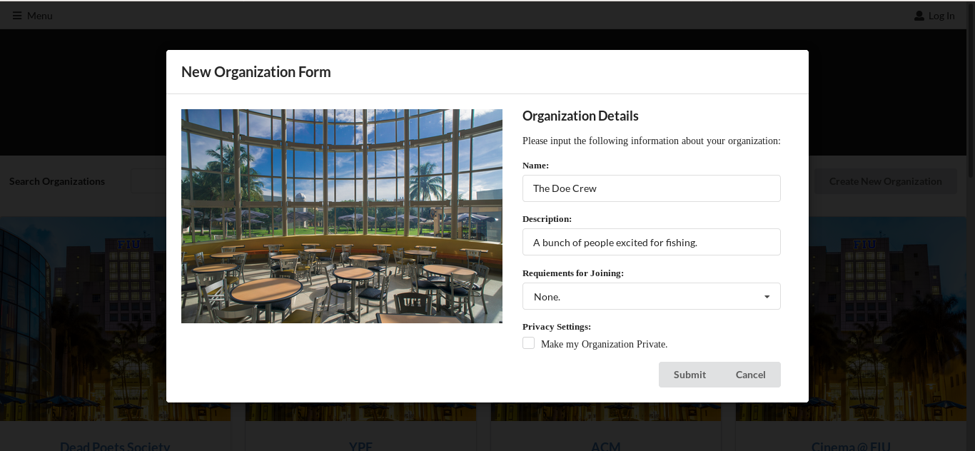
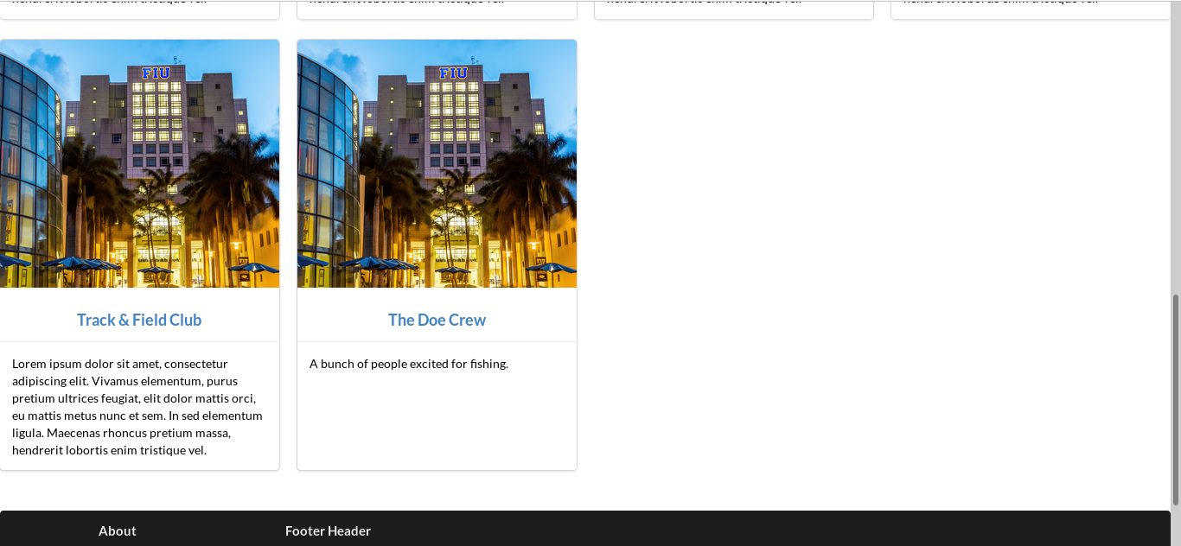
User Interface Design SOS16

Slide 10
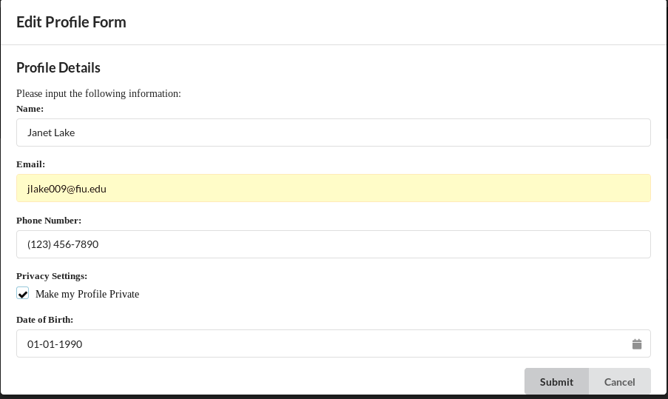
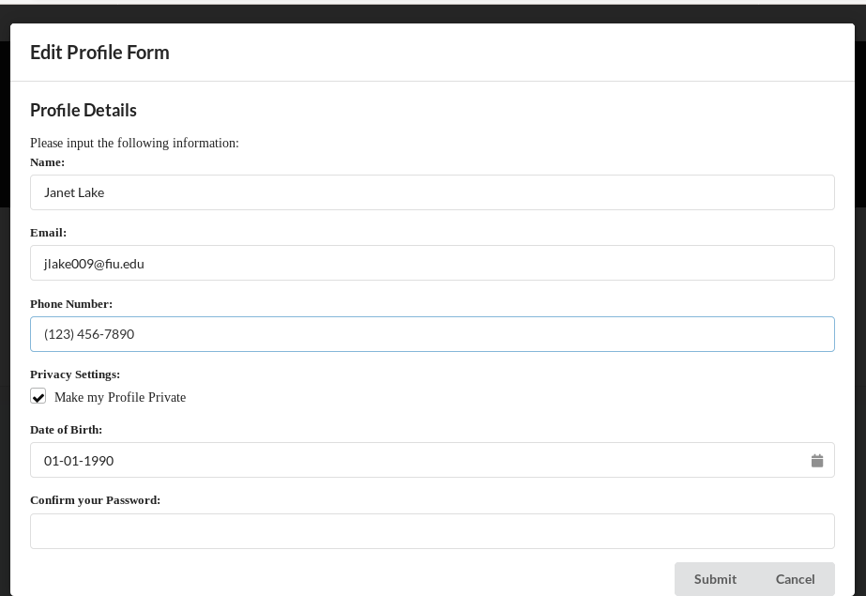
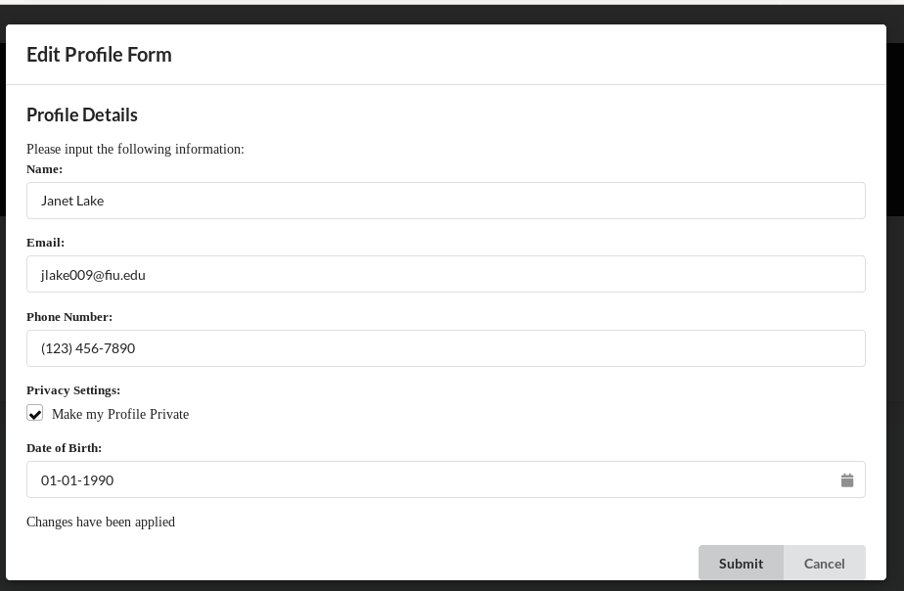
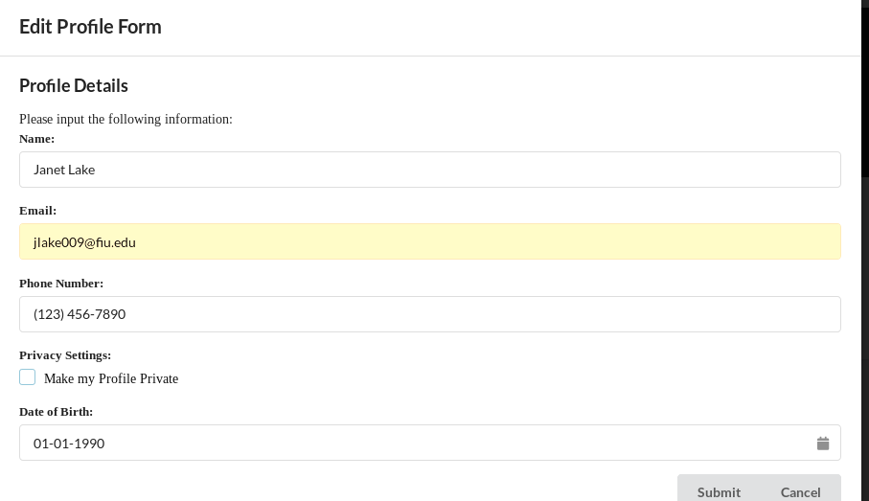
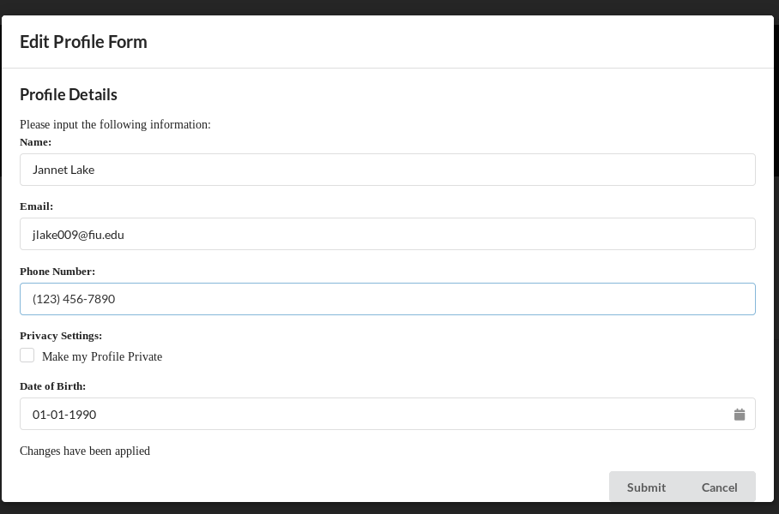
User Interface Design SOS07

Slide 11
Requirement Analysis SOS16
Entities
User
Organization
Role
Boundary
Organization Page
Control
SOS
Data Storage

Slide 12
Requirement Analysis SOS07
Entity Objects:
User
Boundary Objects:
Profile Page
Edit Profile Form
Control Objects:
SOS
Data Storage

Slide 13
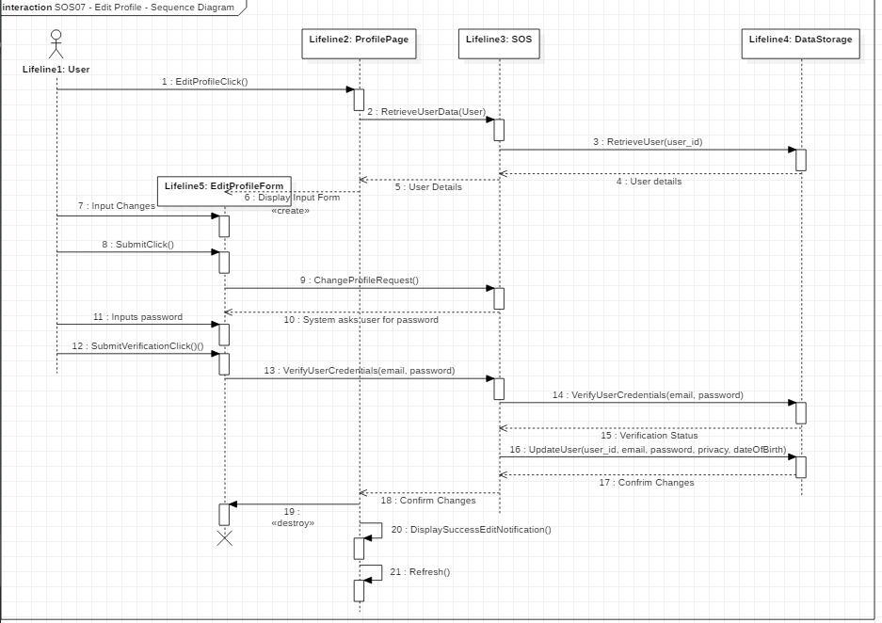
Sequence Diagram SOS07

Slide 14
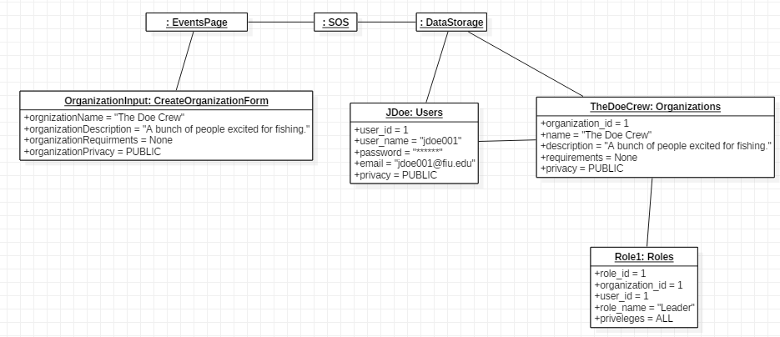
Object Diagram SOS16
Notes:
Change object diagram

Slide 15
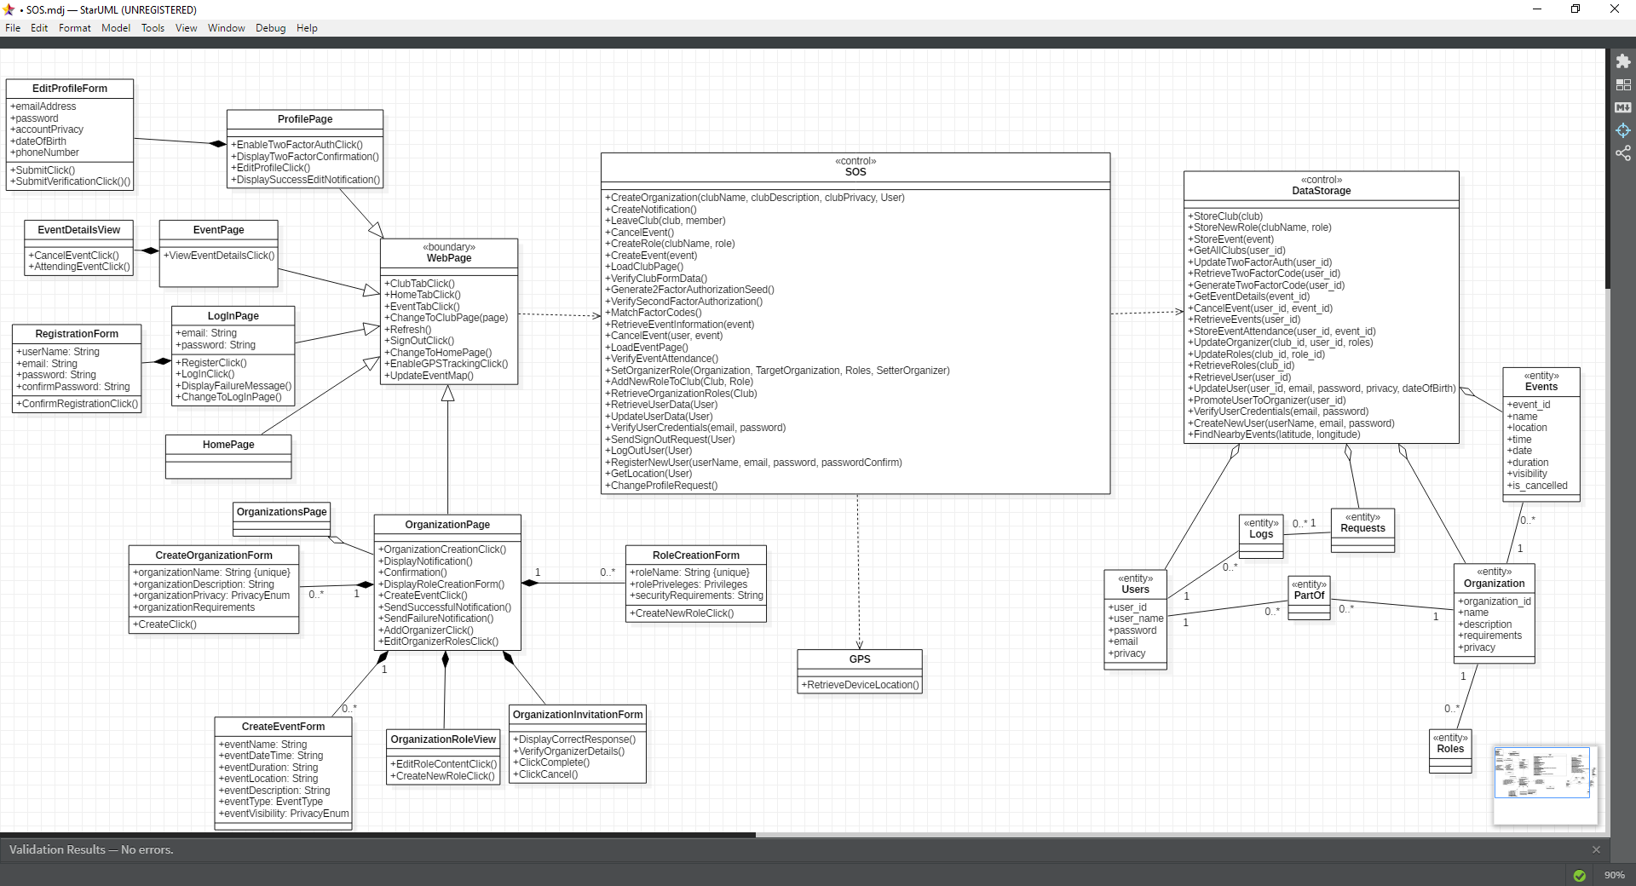
Class Diagram for SOS
Notes:
Change class diagram

